Slide 1
Case Study: Visualizing Investment data in Tableau
Presented by - Divya Paunikar

Slide 2
Agenda
To gain proper insights through the dataset.
Wireframe for Visualization and Dashboards.
Budget Estimation and POC.
Problem Statements and its respective Solutions.

Slide 3
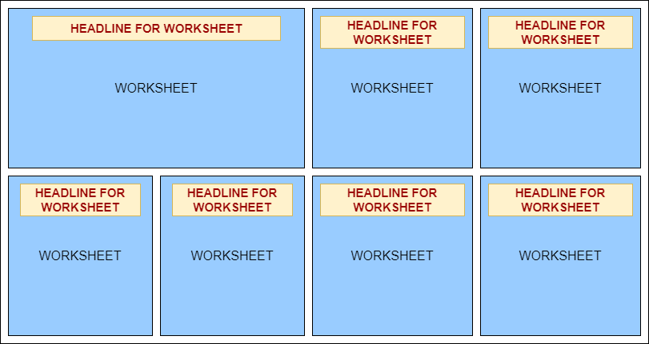
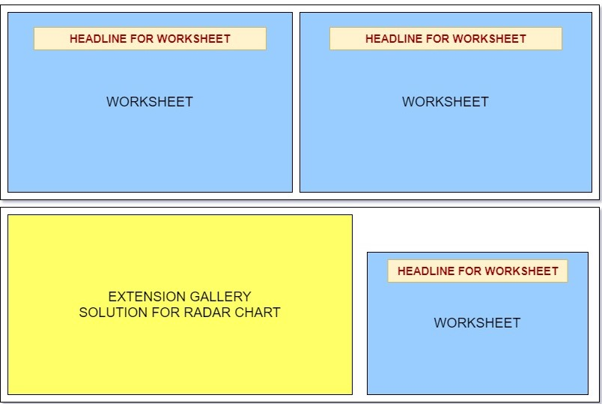
There is a dataset being shared by the Client and due more of the Manual work faced by the client,
we have created Visualizations and Dashboard dynamically by using Tableau Desktop Professional.
Here is the outline of the Visualization.

Slide 4
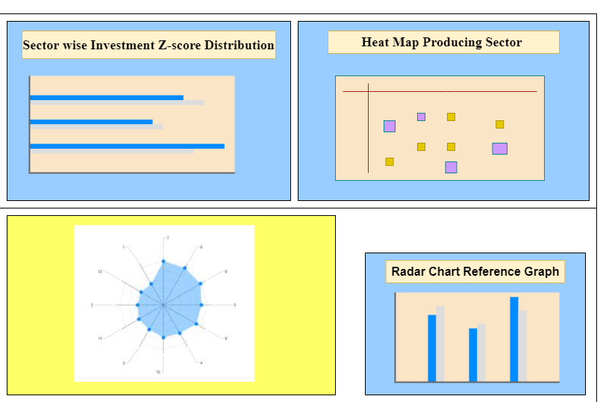
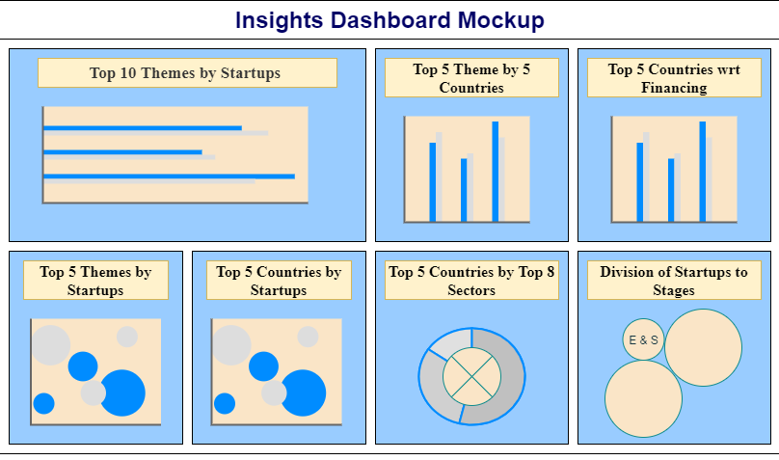
Wireframe for Dashboards:

Slide 5
Budget Estimation and poc
Key Requirements for Visualisation :-
Windows OS, Tableau Desktop
Wireframing Tools such as Draw.io will be used for Dashboard designs.
Tableau Desktop Professional Software at $70 per month.
Tableau Public for Publishing the project.

Slide 6
Problem statements
There are visualization need to be done based on investment dataset as follows:
Top 10 Themes by Count of Startups
Radar Chart producing Top 10 Investors and Startups
Top 5 Themes and Countries by Startups
Sector wise Z-score Distribution of Investment
Top 5 Countries wrt Financing
Heat Map Producing Sector Wise Themes
Top 5 Countries Based on Top 8 Sectors showing total investment till date
Division of Startups to Stages
Top 5 Theme based on Startups by 5 Countries

Slide 7
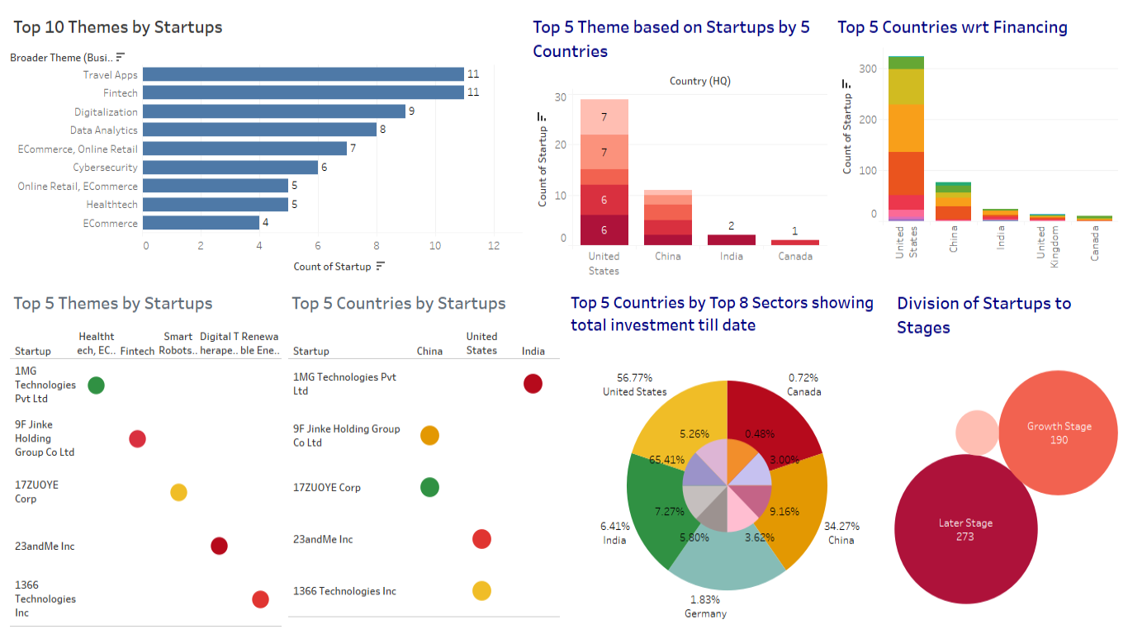
There are Dashboards Generated Based on these Problem statements as follows:

Slide 8
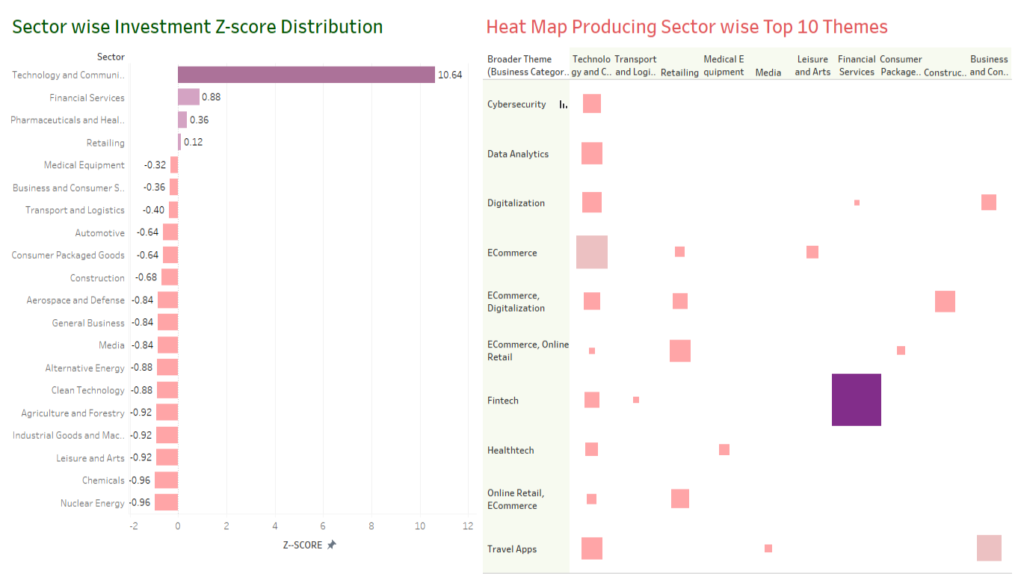
Sector Wise Representation of Investments

Slide 9
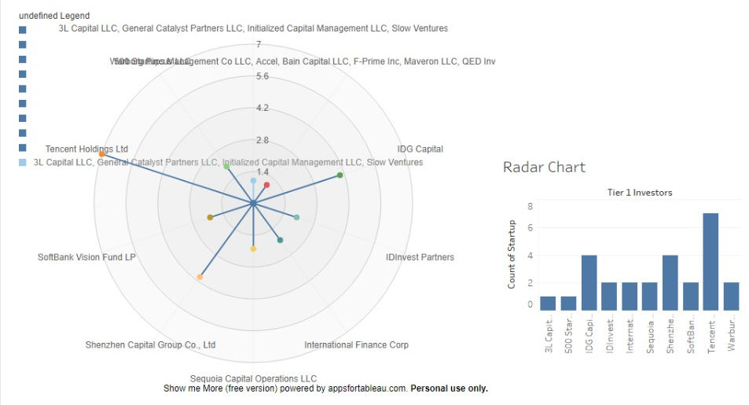
Radar Chart for Top 10 Investors and no of Startups

Slide 10
Conclusion and SCope
All the Problems shared by the Client has been successfully completed with many interesting Visualizations and Dashboards.
It has been observed that the investment dataset has some deviations in the investments in some sectors of the country and many has given profit as well.
SCOPE
By looking at the insights generated, client can easily work on some factors to gain more profits in their projects.

Slide 11

This Photo by Unknown Author is licensed under CC BY-NC-ND

